Slide 1
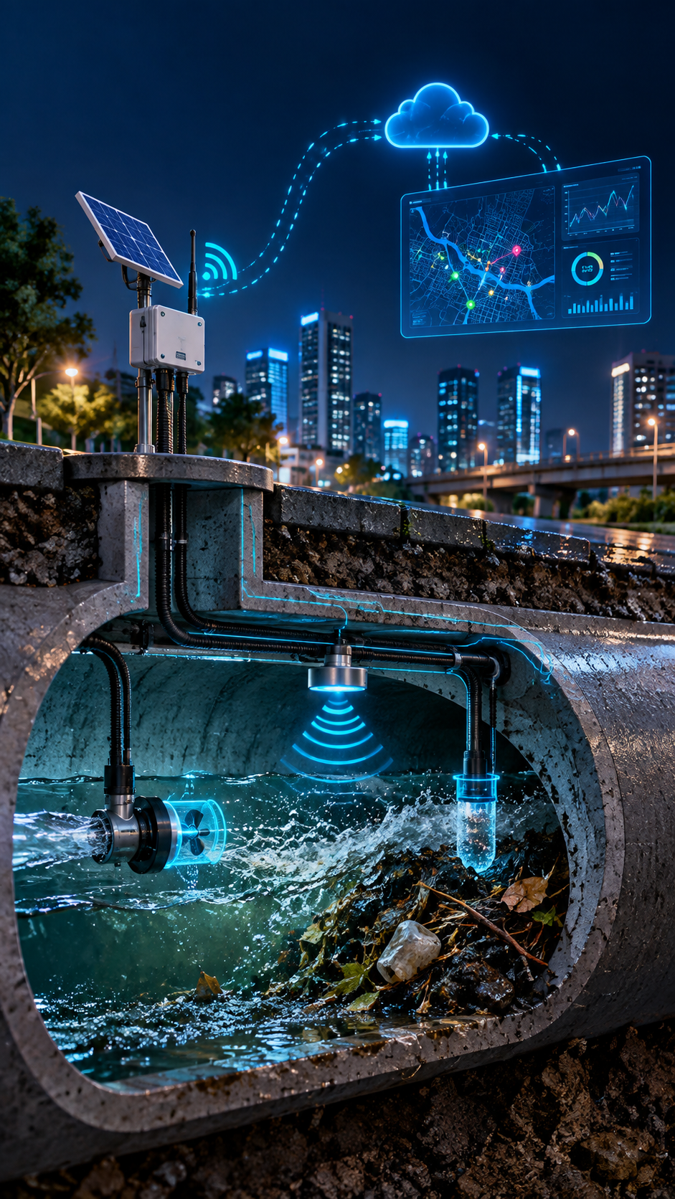
Smart IoT-Based Drainage Blockage Prediction System
T.RAJASARANYA
B.KAMALI
C.Rajisha

Slide 2
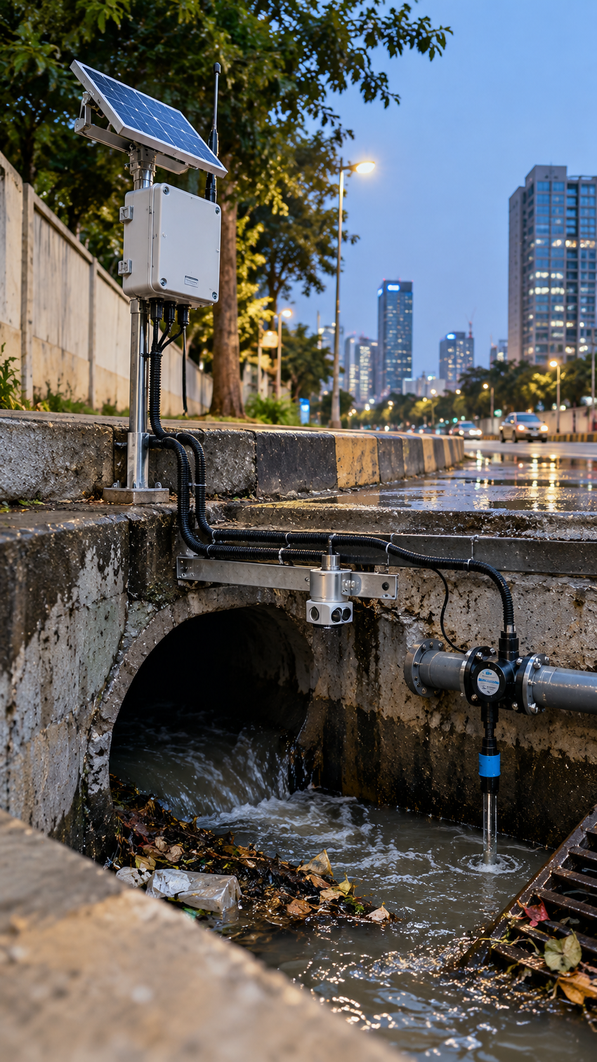
WHAT IF A DRAIN BLOCKAGE GOES UNDETECTED?
BLOCKAGE
Waste and debris block the drainage flow.
WATER RISES
Water level starts rising rapidly inside the drain.
URBAN FLOODING
Drain overflow can lead to road flooding and public inconvenience.
NO EARLY ALERT
The blockage may not be detected in time.

Slide 3

How the System Responds to a Drain Blockage
From water-level monitoring to early warning — automatically.
Detect
Ultrasonic sensor continuously measures the water level.
Analyze
ESP8266 calculates the Rate of Rise (RoR) of water.
Locate
predict
Abnormal rise in water level indicates a possible downstream blockage.
Alert
Alert
Location-based warning is sent to municipal workers via Wi-Fi.

Slide 4

How Does It Know That a Drain Is Blocked?
The system continuously monitors the water level inside the drain. A rapid increase in water level indicates a possible downstream blockage. Instead of waiting for overflow, the system detects the risk early using the Rate of Rise (RoR).
Rapid water level raise
Rate of Rise (RoR) Analysis
Blockage Prediction
The ultrasonic sensor continuously measures the distance between the sensor and water surface. A sudden rise in water level is detected immediately.
The impact sensor registers collision force magnitude. Combined with accelerometer data, this distinguishes a crash from a pothole or speed bump.
The ESP8266 calculates how fast the water level is increasing over time. An abnormal rise indicates restricted water flow.
The system predicts blockage based on the speed of water rise, allowing action before the drain overflows.

Slide 5
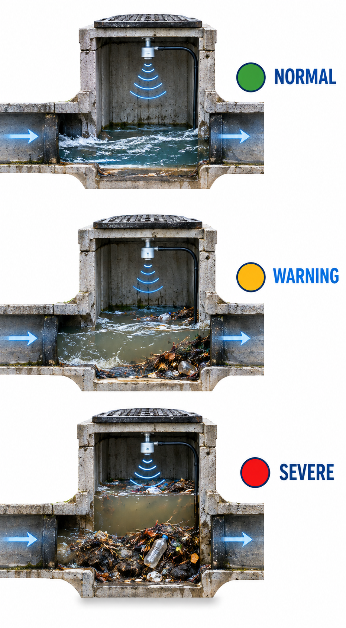
Not Every Water Rise Means a Blockage
Water levels in drains can change due to normal flow or rainfall. The system analyzes the Rate of Rise (RoR) to identify the level of blockage risk. This helps municipal workers respond based on the urgency of the situation.
🟢 NORMAL
Slow rise + normal water flow
Response: Continue monitoring.
🟡 WARNING
Faster rise + restricted water flowResponse: Possible blockage detected; send warning alert.
🔴 CRITICAL
Rapid rise + high water level
Response: High blockage risk; send immediate alert to municipal workers.

Slide 6

Finding the Blocked drain
The system identifies the exact manhole location where abnormal water rise is detected. The location information is attached to the blockage alert, helping municipal workers quickly find and clear the affected drain.
Manhole Location
Each monitoring unit is assigned to a specific manhole/location for easy identification.
Blockage Risk Level
The system classifies the condition as Normal, Warning, or Severe based on the Rate of Rise (RoR).
🚨 BLOCKAGE DETECTED
Location: Manhole – MH-07
Status: SEVERE
Water Level: HIGH
RoR: Above Threshold
Time: 10:42 PM
Action: Immediate Inspection Required
Timestamp of Detection
The exact date and time of the abnormal water rise is recorded and sent with the alert.

Slide 7
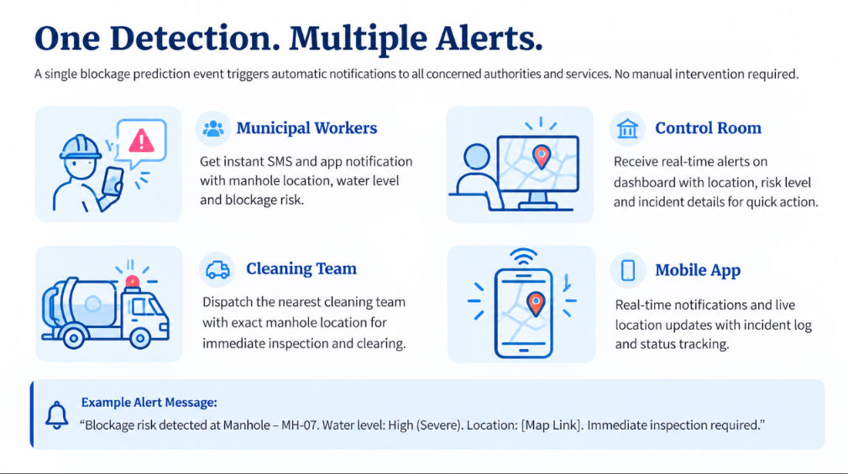

Slide 8
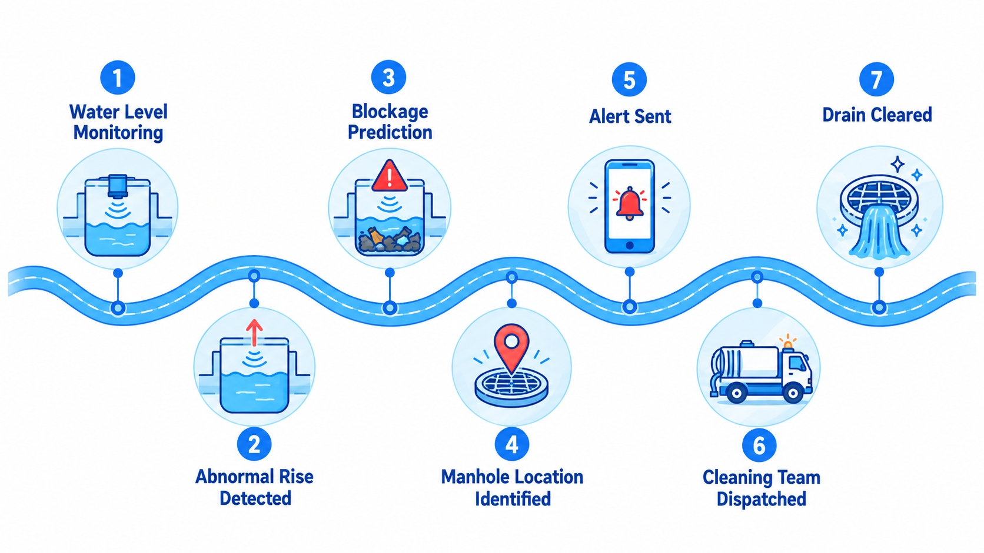

Slide 9
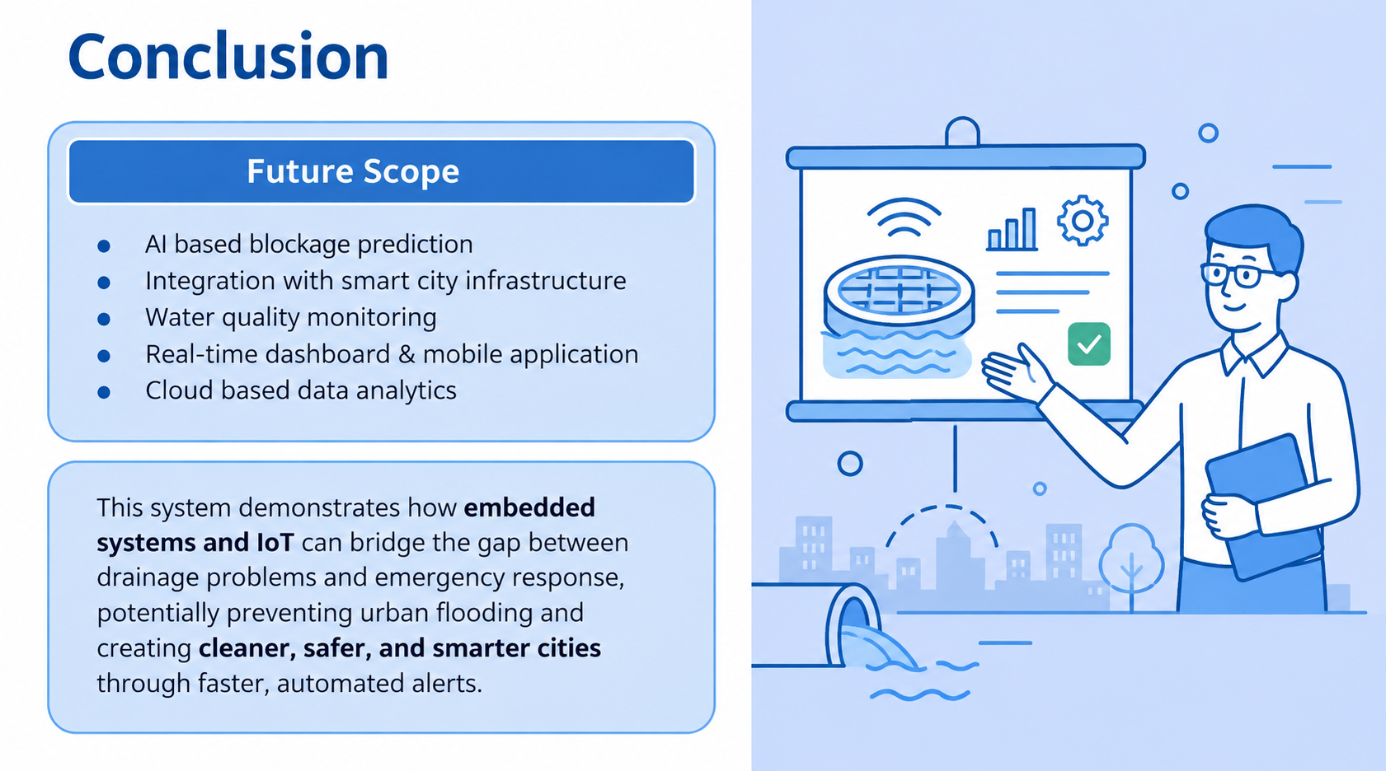

Slide 10


THANK
YOU

